Slide 1
INSTAGRAM USER ANALYTICS
2. CASE STUDY ON INSTAGRAM USER ANALYSIS.

Slide 2
PROJECT DESCRIPTION
This project is about deep learning on SQL commands to get certain results .
From the given Dataset we need to extract mentioned data in specific.
INSTAGRAM USER ANALYTICS

Slide 3
Implementation

Slide 4
TECHNICAL RESOURCES
I have used my MySQL WORKBENCH (8.0.31)
BECAUSE this is one of efficient choices , works well with Mysql and SQL as well.

Slide 5
I Learnt how to create a Database in workbench
Manipulating it and tools required in it .
How to delete a database .
Creation
Manipulation
Deletion
I have also learnt about Aggregate and sorting functions as well
INSIGHTS

Slide 6
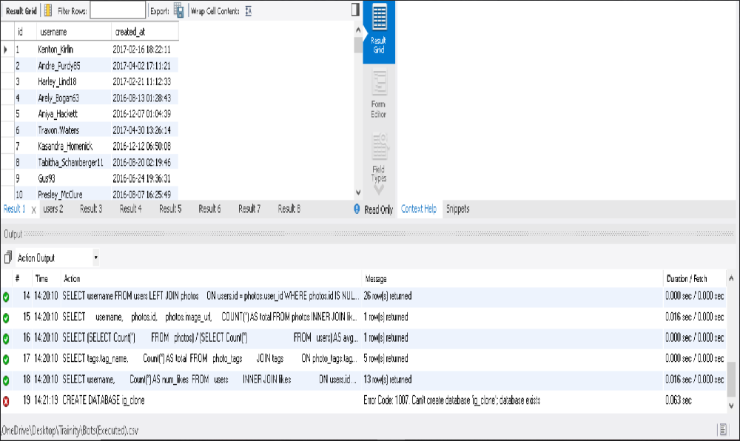
RESULT
CREATION OF DATABASE

